Slide 1
Lesson 8 – Optional, DateTime API, Gradle

Slide 2
Lesson Goals
DateTime API
Optional class
Gradle

Slide 3
Date Time API

Slide 4
Java Date Time API
Since Java 8
Easy for understanding
Flexible API
Immutable (i.e. thread safe)
Can work wiith Zoned time

Slide 5
Most used classes in “java.time.*” package
LocalDate – represents a date in ISO format (yyyy-MM-dd) without time.
LocalTime - represents time without a date.
LocalDateTime is used to represent a combination of date and time.

Slide 6
Working with LocalDate
LocalDate localDate = LocalDate.now(); LocalDate.of(2015, Month.FEBRUARY, 20); LocalDate.parse("2015-02-20"); LocalDate tomorrow = LocalDate.now().plusDays(1); LocalDate previousMonthSameDay = LocalDate.now().minus(1, ChronoUnit.MONTHS); DayOfWeek sunday = LocalDate.parse("2016-06-12").getDayOfWeek(); int twelve = LocalDate.parse("2016-06-12").getDayOfMonth(); boolean leapYear = LocalDate.now().isLeapYear();

Slide 7
Working with LocalTime
LocalTime now = LocalTime.now(); LocalTime sixThirty = LocalTime.parse("06:30"); LocalTime sixThirtyParsed = LocalTime.of(6, 30); LocalTime sevenThirty = LocalTime.parse("06:30").plus(1, ChronoUnit.HOURS); int six = LocalTime.parse("06:30").getHour(); boolean isBefore = LocalTime.parse("06:30").isBefore(LocalTime.parse("07:30"));

Slide 8
Working with LocalDateTime
LocalDateTime.now(); LocalDateTime.of(2015, Month.FEBRUARY, 20, 06, 30); LocalDateTime.parse("2015-02-20T06:30:00"); LocalDateTime.of(LocalDate.now(), LocalTime.now());

Slide 9
Date and Time Formatting
Common format is ISO-8601 – ‘2011-12-03’ or ‘2011-12-03+01:00’.
LocalDateTime localDateTime = LocalDateTime.of(2015, Month.JANUARY, 25, 6, 30);
String localDateString = localDateTime.format(DateTimeFormatter.ISO_DATE);
localDateTime.format(DateTimeFormatter.ofPattern("yyyy/MM/dd"));

Slide 10
Billion-Dollar mistake

Slide 11
NPE aka “Billion-Dollar mistake”
Tony Hoare the creator of the null reference
Created while designing ALGOL W
Meant to model the absence of a value
“... simply because it was so easy to implement”
The cause of the Null Pointer Exceptions

Slide 12
Most frequent exception

Slide 13
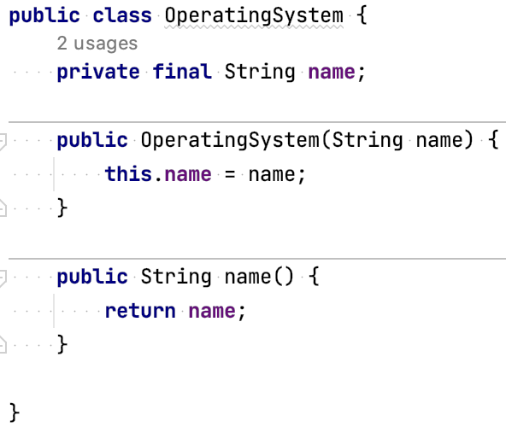
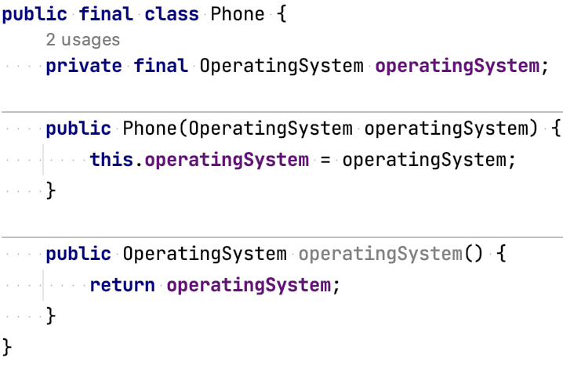
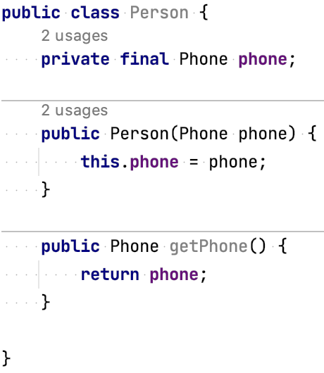
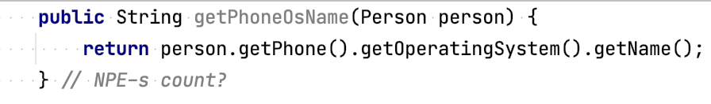
NPE example

Slide 14
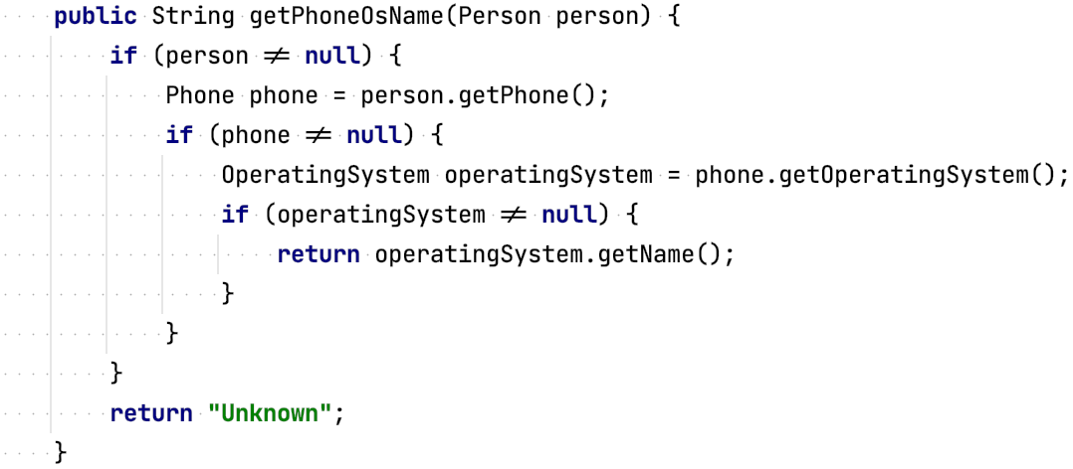
Attempt 1: Null checks

Slide 15
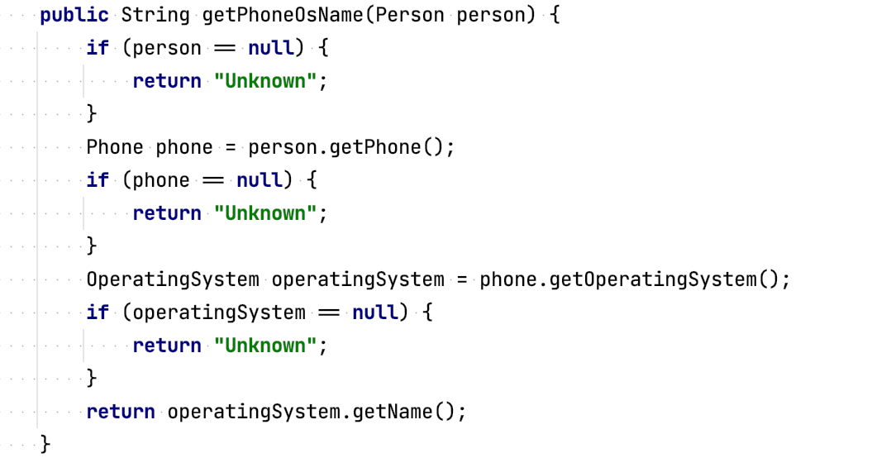
Attempt 2: Multiple Exits (Fail/Return First pattern)

Slide 16
The problem – NullPointerException
var operatingSystem = new OperatingSystem("Symbian");
var operatingSystem = new OperatingSystem(null);
var phone = new Phone(operatingSystem); var person = new Person(phone); String phoneOsName = getPhoneOsName(person); println(phoneOsName.length());
Exception in thread "main" java.lang.NullPointerException

Slide 17
Optional – for the rescue

Slide 18

Optional – for the rescue
New class located at java.util.Optional<T>
Encapsulates optional values
It wraps the value if it’s there, and is empty if it isn’t
Optional.empty()
Signals that a missing value is acceptable
We can’t easy operate with null, but we can operate with Optional.empty()

Slide 19
Warning before we progress
Optionals are not intended to replace all null references
Design more comprehensible APIs
Forces caller to deal with the absence of a value

Slide 20
How to create Optional objects
Empty Optional
Optional<T> opt = Optional.empty();
Optional<Phone> phoneOpt = Optional.empty();
Optional from a non-null value
Optional<T> opt = Optional.of(T value);
Optional<Phone> phoneOpt = Optional.of(phone);
Optional from a null value
Optional<T> opt = Optional.ofNullable(T value);
Optional<Phone> phoneOpt = Optional.ofNullable(phone);

Slide 21
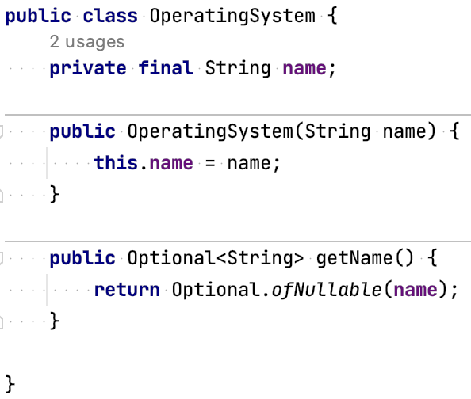
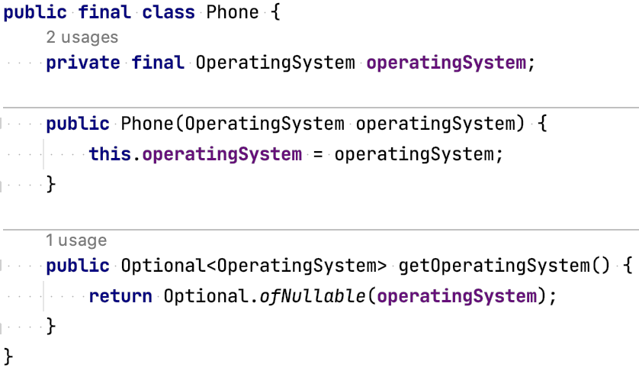
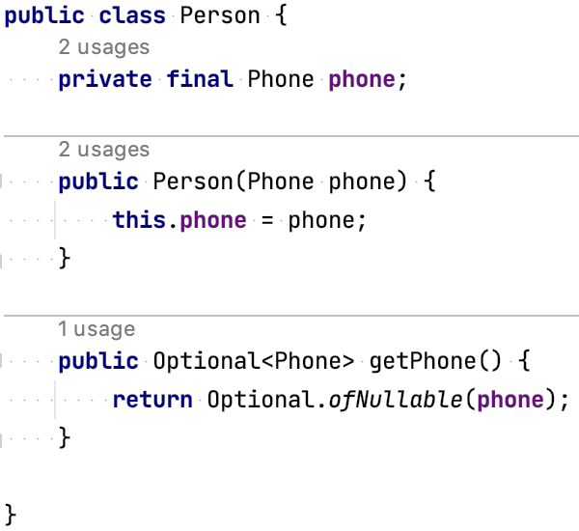
Attempt 3: Refactoring with Optional

Slide 22
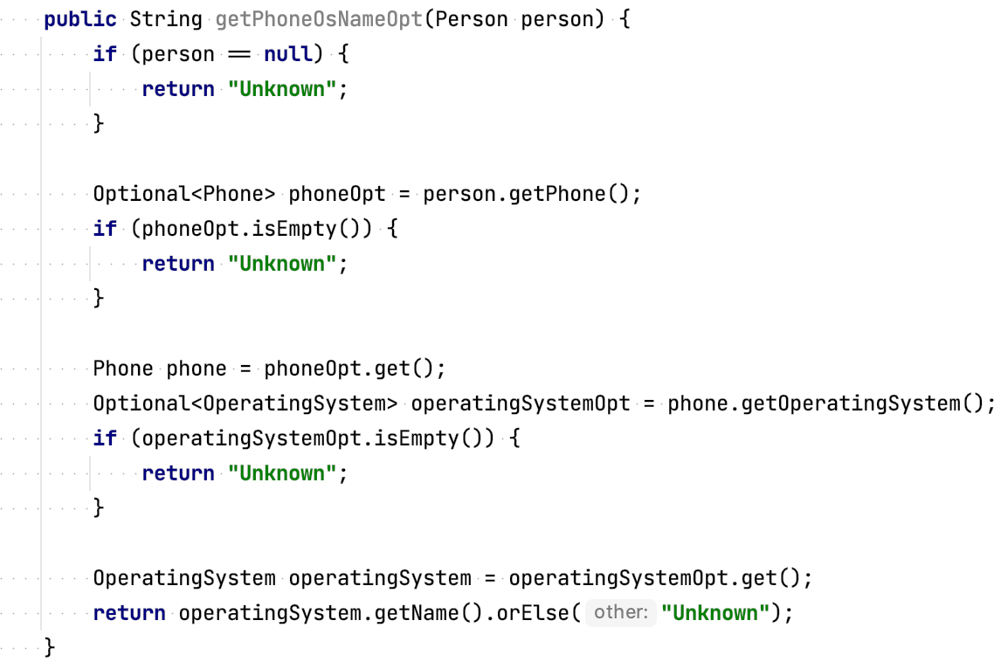
Attempt 3: Optional is easy 😈

Slide 23
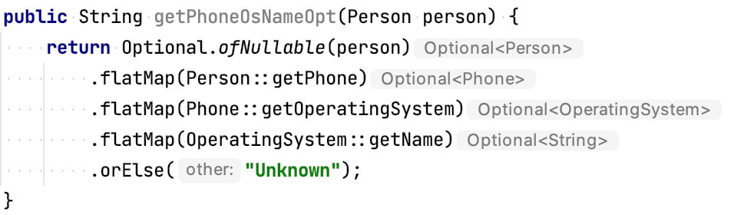
Attempt 4: Optional is easy 😇

Slide 24
Optional Methods
T get(); boolean isPresent(); boolean isEmpty(); void ifPresent(Consumer<? super T> action); void ifPresentOrElse(Consumer<? super T> action, Runnable emptyAction); Optional<T> filter(Predicate<? super T> predicate); <U> Optional<U> map(Function<? super T, ? extends U> mapper); <U> Optional<U> flatMap(Function<? super T, ? extends Optional<? extends U>> mapper); Optional<T> or(Supplier<? extends Optional<? extends T>> supplier); Stream<T> stream(); T orElse(T other); T orElseGet(Supplier<? extends T> supplier); T orElseThrow(); <X extends Throwable> T orElseThrow(Supplier<? extends X> exceptionSupplier) throws X;

Slide 25
Optional Summary
Null references have been historically introduced to signal absences
Optional has been introduced to model presence or absence
Can create Optional objects using factory methods:
Optional.empty
Optional.of
Optional.ofNullable
Optional supports methods suited for functional programming
Using Optional forces callers to actively deal with potential absences
Optional can help you design better APIs

Slide 26

What is

Slide 27
Software build process
Building software is hard and require big amount of time!

Slide 28
Software build process
Building software is hard and require big amount of time!
Software build process:
Develop
Test
Assemble
Deploy
Integrate
Repeat
Again and again and again… 🤪

Slide 29
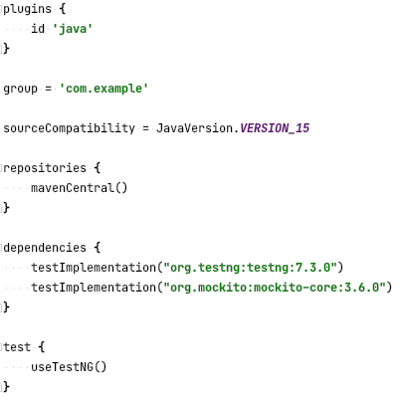
Gradle Project Config Example

Slide 30
Gradle main points
Can use Wrapper instead separate instalation in system 😍
Build Scripts are code in Groovy/Kotlin DSL 😎
Pluggable to work not only with Java 😉
Flexible build configurations(declarative style) 🙃
Some times called “StackOverflow driven build system” 🤕

Slide 31
Gradle core concepts
Build script: a build.gradle configuration script supporting one or more projects.
Project: a component that needs to be build. It is made up of one or more tasks.
Task: distinct step required to perform the build.

Slide 32
Gradle core concepts
Publication: the artifact prooduced by the build process.
Dependencies: tasks and projects depending on each other (internal) or on third-party artifacts (external).
Transitive dependencies: the dependencies of a project may themselves have dependencies.

Slide 33
Gradle core concepts
Repositories: the “places” that hold external dependencies.
Dependency Graph: shows what depends on what.
Plugins: external tools that can customize build process

Slide 34
Gradle Plugin power
Add a task to a project
Pre-configure these tasks with reasonable defaults
Add dependency configurations
Add new properties and methods to existing objects

Slide 35
Gradle Project Config Example

Slide 36
The Build Lifecycle
Initialization: initialization of the project
Configuration: configuration of the project (computes the dependencies graph)
Execution: executes the sequence of build tasks

Slide 37
Multi Module Projects
Each module/project with its own “build.gradle”
Each module described in “settings.gradle” file in the root of project folder
Root project “build.gradle” should contain only configs related to all or subprojects

Slide 38
Gradle Example
Show Gradle Tool in IDEA
Show Dependency Graph
Execution of tasks from command line
Multi module project structure
Multiple projects configuration (subprojects)
JAR building

Slide 39
Homework Task (Optional, DateTime)
Use an Optional as a return type for methods that may return 'null' or throw exception (example input reader methods may return Optional)
Add additional field to “Student” class that holds information about date and time when student passed an exam

Slide 40
Homework Task (Gradle)
Integrate Gradle into project
Migrate adding of third-party libs by using Gradle
Create two child modules of “Homework” module:
domain (store only business logic code)
console-app (store console app related code)

Slide 41
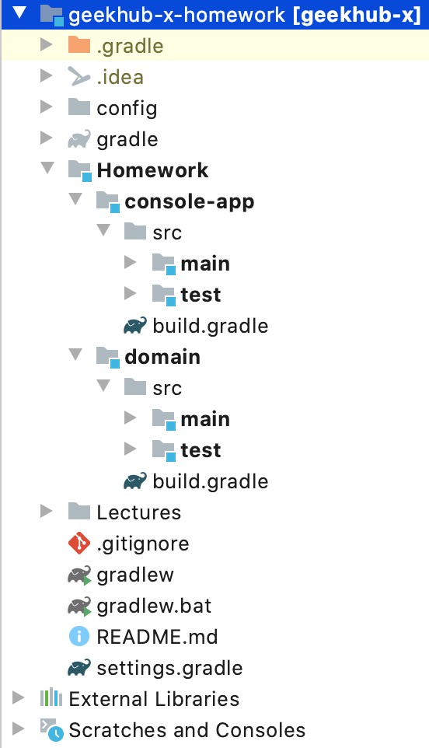
Homework Task Example Project Structure

Slide 42
Links
https://www.baeldung.com/java-optional
https://www.baeldung.com/java-8-date-time-intro
https://www.baeldung.com/gradle

Slide 43
Thanks!
Any Questions?
Or find us in Slack:
@Yaroslav Brahinets
@Vasya Rudas

